Slide 1

Hamza Yiğit Ünsal’s Team Progress Presentation
Team Leader: Hamza Yiğit Ünsal
Members: Mustafa Taha Akoğlu İbrahim Çağlar Yıldırım

Slide 2
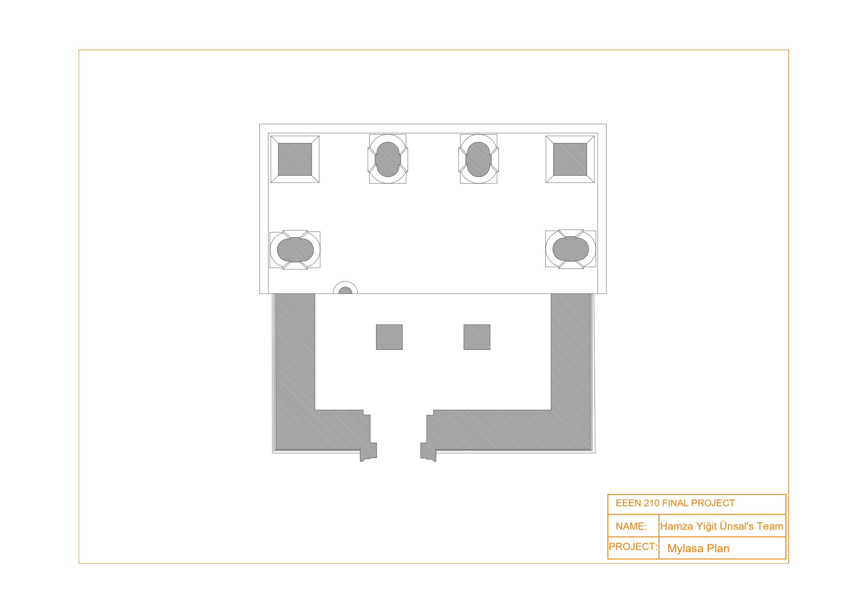
Mylasa Plan Progress:

Slide 3
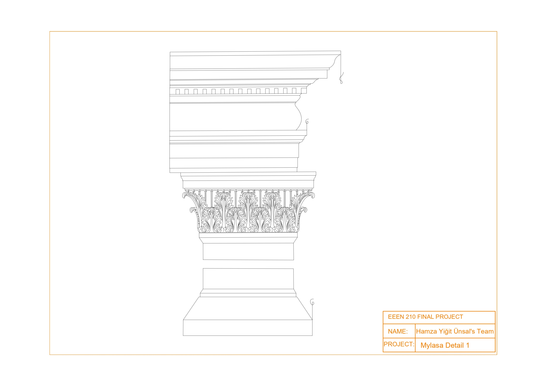
Mylasa Detail 1 Progress:

Slide 4
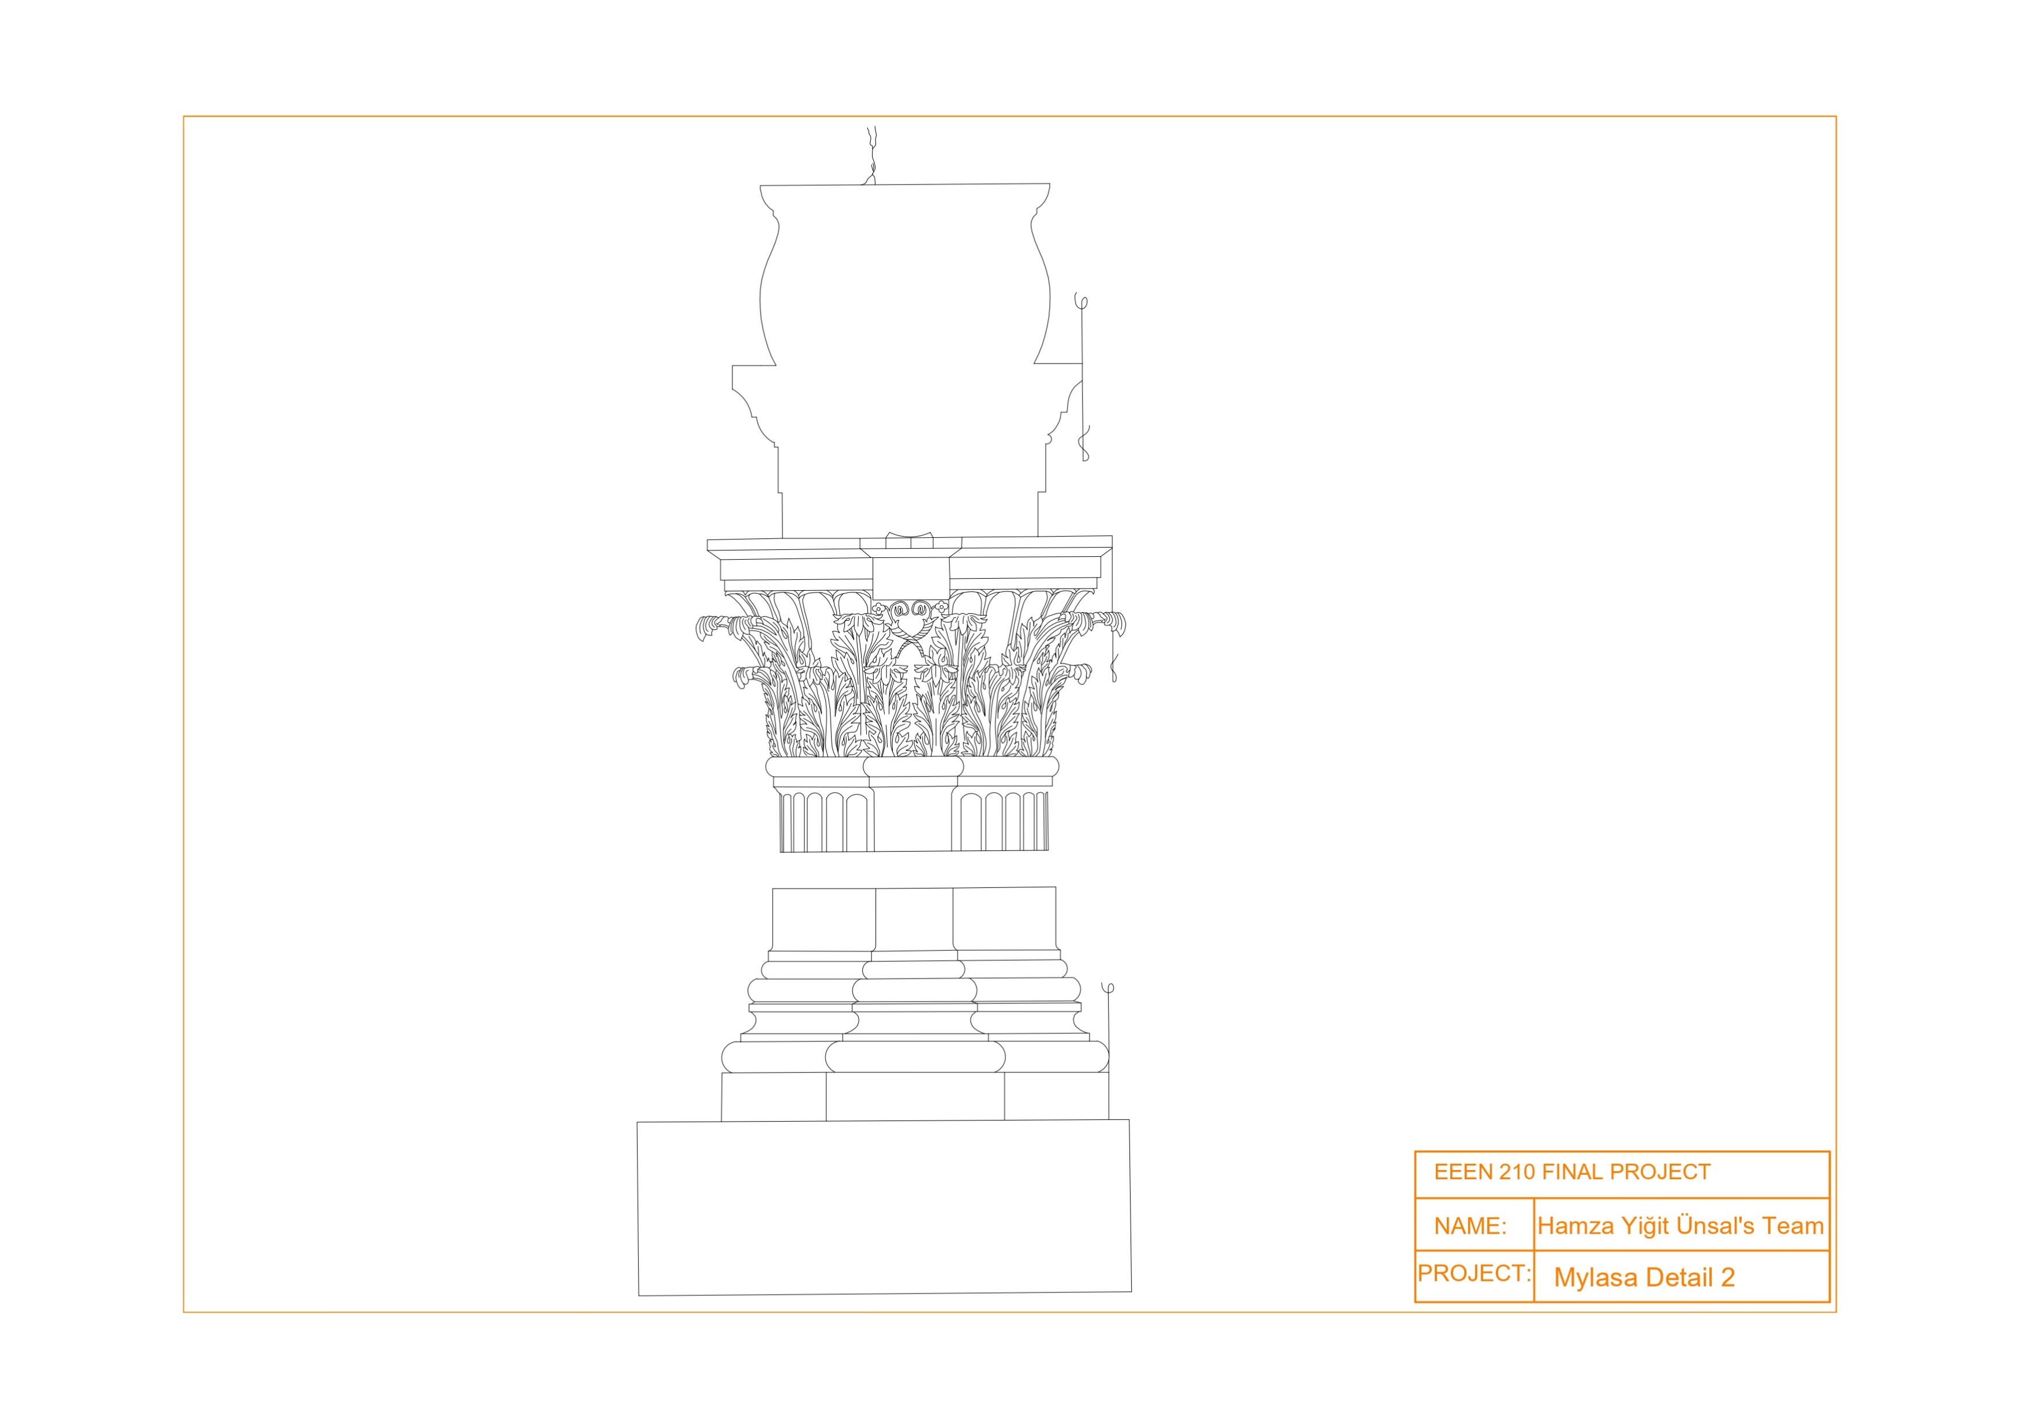
Mylasa Detail 2 Progress:

Slide 5

Mylasa Facade Progress:

Slide 6

Thank you for your time

